Slide 1
Giving a science research talk How to (and to not) leave your audience behind
Brian W. Mulligan
University of Texas at Austin
Grad Student – Post-Doc Seminar
University of Texas at Austin
4 Nov. 2016

Slide 2
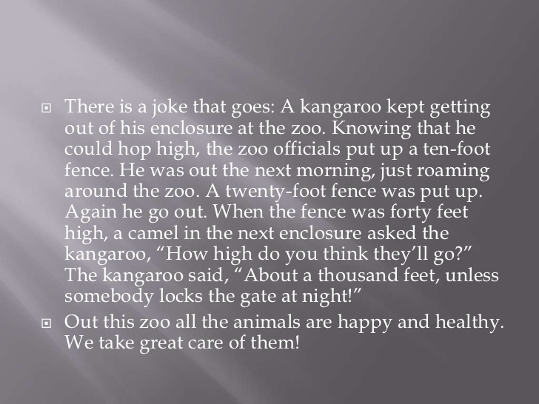
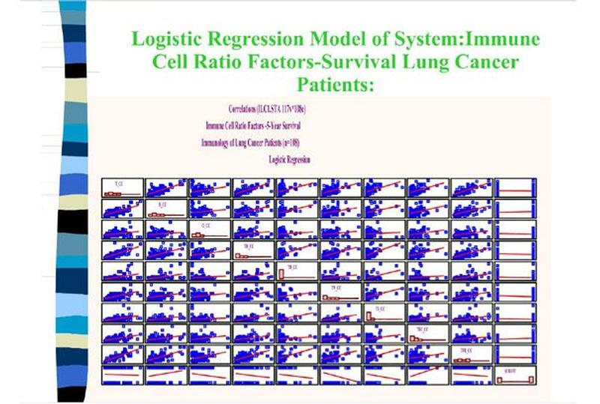
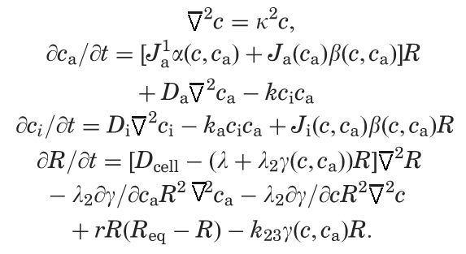
Background

Slide 3
Plan for this talk
Things to think about beforehand
Creating slides
Organizing talk
Giving your talk

Slide 4
Plan for this talk
Things to think about beforehand
Creating slides
Organizing talk
Giving your talk

Slide 5
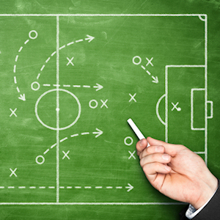



Don’t wing it
Plan your talk
Define your goals
Preparing 1/2

Slide 6

Be aware of your audience
Undergrads?
Your sub-sub field, sub field, or anyone?
Their entire attention may not be on you
Have they heard similar talks before?
Preparing 2/2

Slide 7
Plan for this talk
Things to think about beforehand
Creating slides
Organizing talk
Giving your talk

Slide 8

Slide design
Illustrate concept
Provide data
Don’t make audience read
Keep audience aware of where you are
Design 1/4

Slide 9
Equations may be OK
X = position
Alpha = …
Sigma = …
Theta = …
k_b = Boltzman constant
T = temperature
Z = redshift
Beta = D.E. dep. On redshift
Omega_Lambda = D.E. energy density …...
$f\left(x\right)=αe^{\left(\frac{−x^{2}}{2σ^{2}}\right)}+sinh\left(θk_{B}T\right)−{\left(1+z\right)}^{β}Ω_{Λ}$
$f\left(x\right)=\left[Spatial\right]+\left[Thermal\right]−{\left(1+z\right)}^{β}Ω_{Λ}$
Do you refer to it later?
What variables / terms are actually important?
Describe every variable unless you’re sure everyone knows them.
Design 2/4

Slide 10
Graphs and plots
Time-stretch factor for B band
B-Band Scale Factor
12
6
0
(Nobili & Goobar 2008)
Count
0.7 1.0 1.2
1
25
13
0
Count
Normalized density
0 0.05 0.12
Redshift
Make sure that axes are legible
16-20 pt text for axes
Use easy to understand axis labels
Use line style & thickness in addition to color
10⁻⁹
10
50
(Mulligan & Wheeler in prep)
Design 3/4

Slide 11
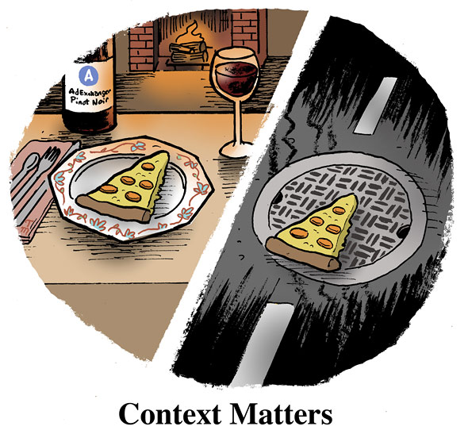

Videos & Images
Just because you can doesn’t mean you should.
Design 4/4

Slide 12
Plan for this talk
Things to think about beforehand
Creating slides
Organizing talk
Giving your talk

Slide 13
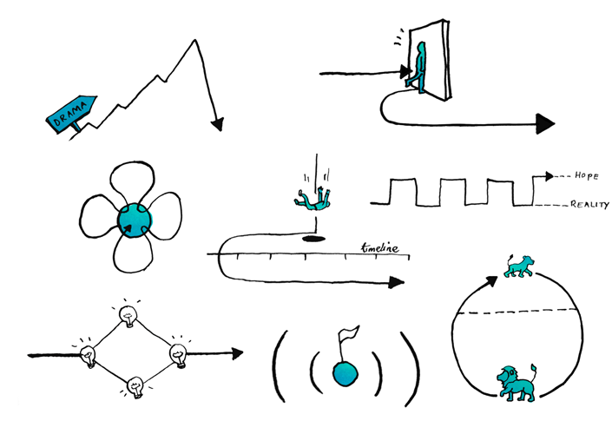
Tell a story
Narrative techniques help guide the brain
Provide framework that can help understanding and highlight important points
http://www.sparkol.com/engage/8-classic-storytelling-techniques-for-engaging-presentations/
Organization 1/3

Slide 14
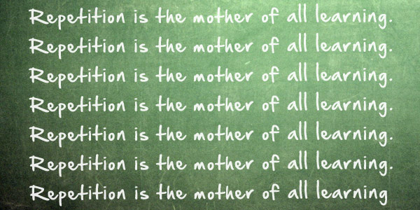
Be repetitive
Reinforces concepts
Helps audience if they’re not fully engaged
Helps if audience isn’t familiar with (sub-sub-) field
Organization 2/3

Slide 15
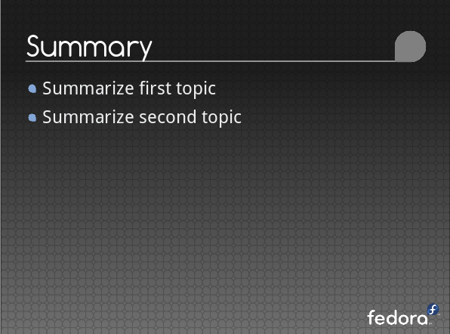
Have a summary slide
Might not have time to give verbal summary.
Emphasize main points in case audience missed them.
Reinforce main points.
Organization 3/3

Slide 16
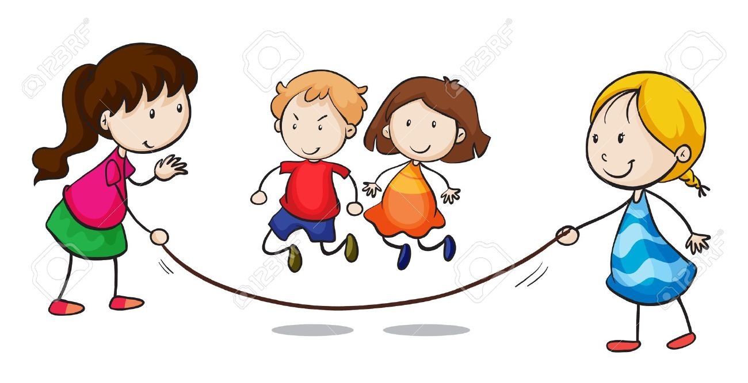
What can (will) you skip?

Slide 17
Plan for this talk
Things to think about beforehand
Creating slides
Organizing talk
Giving your talk

Slide 18
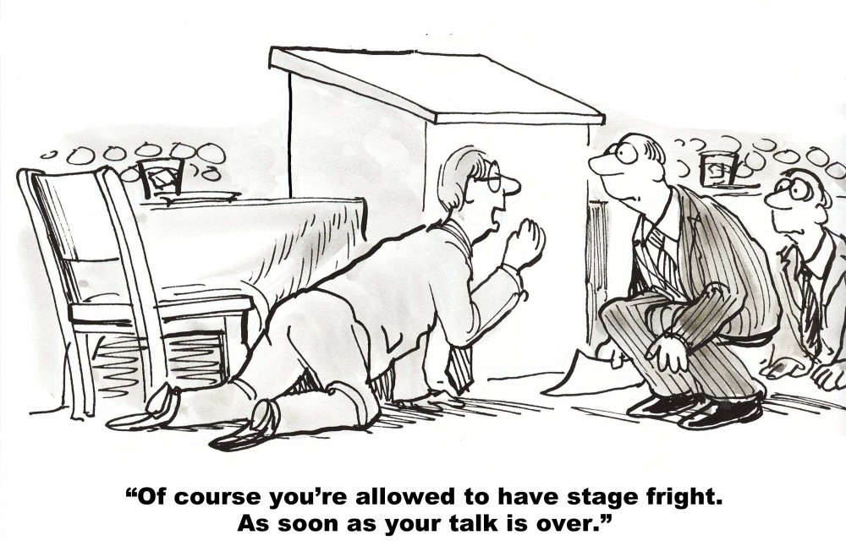
Be aware of your nervous tics
Verbal ticks?
“So”
Kinetic tics?
Pacing, gripping podium / etc.,
Best method
record yourself and watch the video
Check out Rice U. ComCoach
http://www.ruf.rice.edu/~comcoach/
Giving Talk 1/2

Slide 19
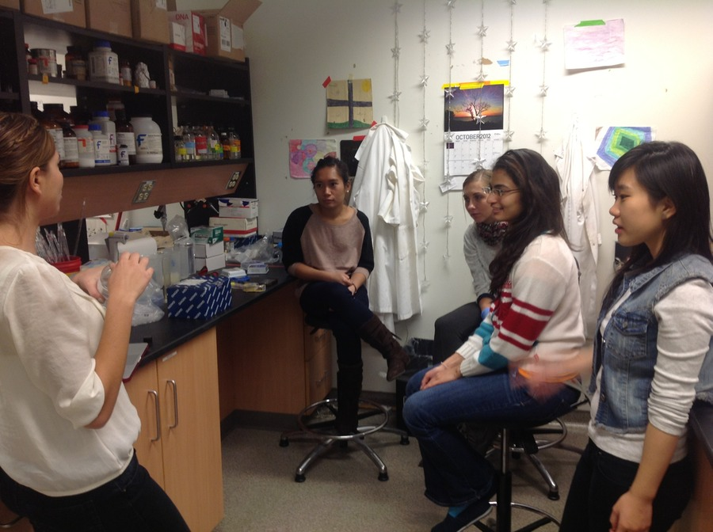
Practice Talks
Self
Small Group
Get critical feedback in real-time
Iteration
Giving Talk 2/2

Slide 20
Summary
Preparation
Audience, Goals, stuff to skip
Slide Design
Use slides to emphasize / illustrate points
Make slides, equations, and graphs easy to digest
Organization
Provide a narrative
Keep reminding audience what you are talking about
Include a summary
Giving your talk
Be aware of your nervous habits

